Slide 1
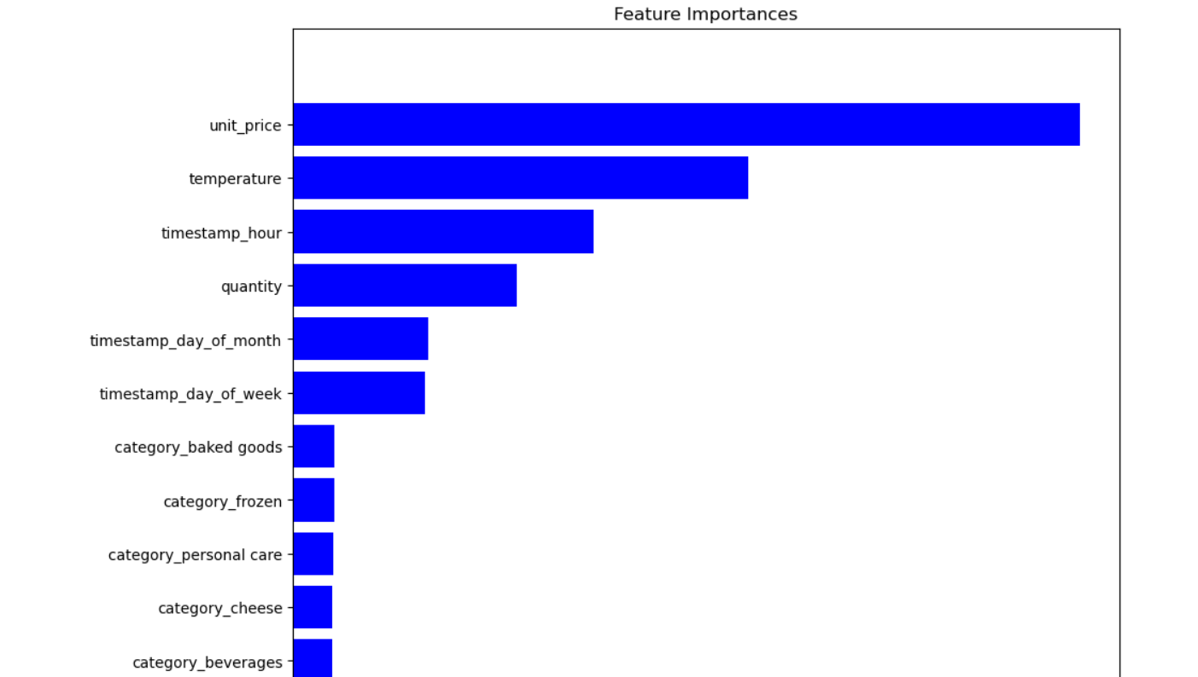
Feature Importance Insight
Feature Importance Insights:
Product Categories: Minimal impact on stock predictions.
Unit Price and Temperature: Significantly influence stock forecasts.
Hour of Day: Crucial for accurate stock level predictions.
Recommendations:
Optimize procurement based on prices and temperature.
Implement time-sensitive inventory management.
Enhance data collection for precise predictions.

